Slide 1


Credit One R Framework Analysis
Marilyn Mcconnell

Slide 2
Goals
Business Problem
Business Goals
Over the past year Credit One has observed an increase in the number of defaulted on loans.
Identify
Identify the ideal borrower
Spot
Spot high-risk borrowers
Define
Define the credit limits per borrower, to eliminate defaulted loans risk.

Slide 3
Goals
Resources Needed
Project Deployment
Access to Credit One data base
Anaconda Navigator system
One data analyst.
Week One - Determine Goals
Week Two - Clean and Prepare Data
Week Tree – Build and Evaluate Models

Slide 4
Data Collection and management
Data Available
30,000 data points, 24 variables summarized in the categories below
Credit Limits
Gender
Education
Marital Status
Age
Payment History
Repayment Status
Default History

Slide 5
Data Collection and Management
Data Quality
Data Management
204 duplicate data points
Two sets of headers
Multiple categorical features
Available data appears to be sufficient, but further analysis will determine if additional variables are needed
All data analysts sign a confidentiality contract. The contract specifies to keep all knowledge obtained during any analysis in strict confidence and to not share with any third parties
All computers are secured with YubiKey. The Key verifies the access comes from our personnel, and not remote hackers

Slide 6
Machine learning Models Build
Techniques Used
Supervised Learning : We will create a model based on the data already collected.
The data it is split in three data sets to ensure the data is:
Trained
Validated
Tested
The tested data is the final performance metric model.

Slide 7
Model Evaluation and Critique
Only the machine learning models with an accuracy greater than 80% will be used in this project

Slide 8
Present results and document
Analysis and Model findings will be presented on May 20th at 7:00 pm

Slide 9
Model Deploy and Maintenance
New model will be trained offline.
Training materials will be distributed during the week of May 20th prior to deployment
Deployment day is schedule for Monday June 6th.

Slide 10
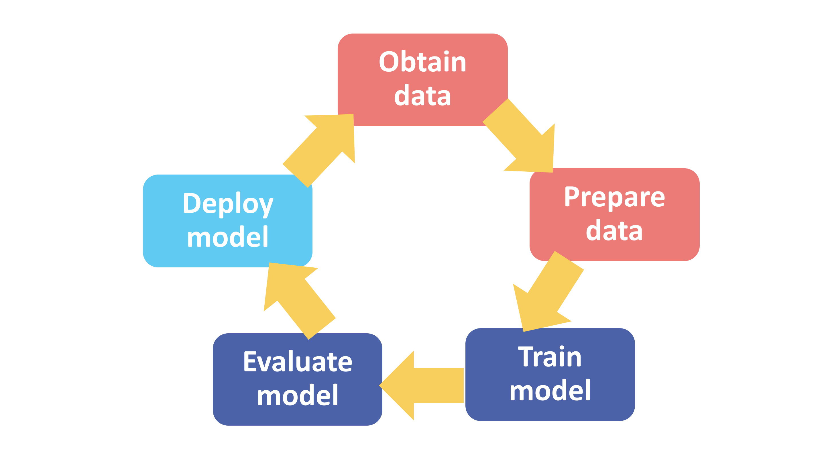
Modeling Process Flow
As mentioned in data collection the data needs cleaning.
Fix structural Issues
25 Features make data cross validation a long and tenuous process

Slide 11

Initial Insights

Slide 12
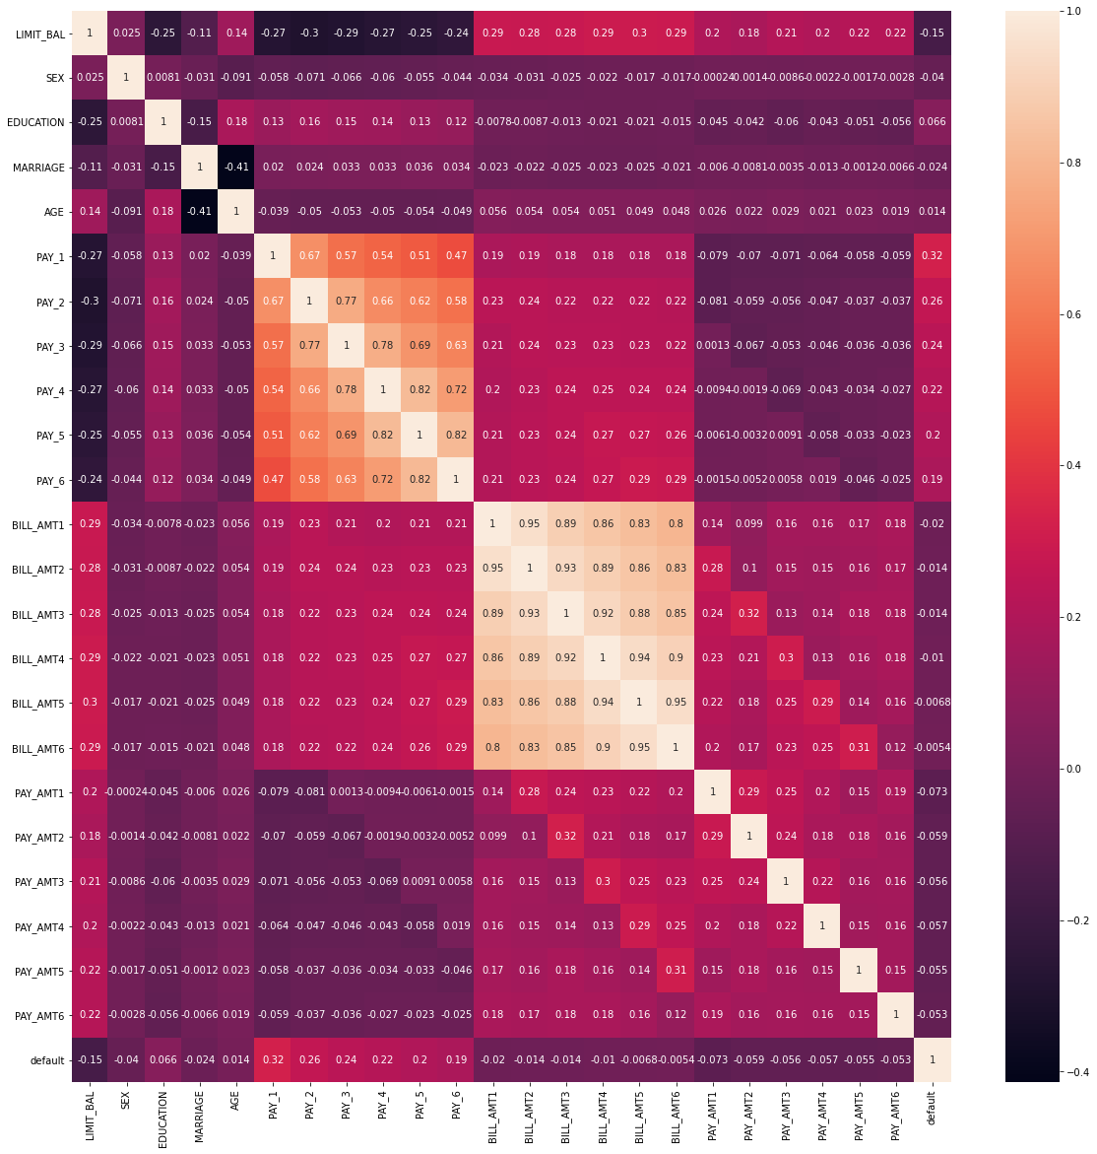
Data Correlation
There is no strong correlation between any of the data features

